Slide 1

What is Machine Learning?

Slide 2
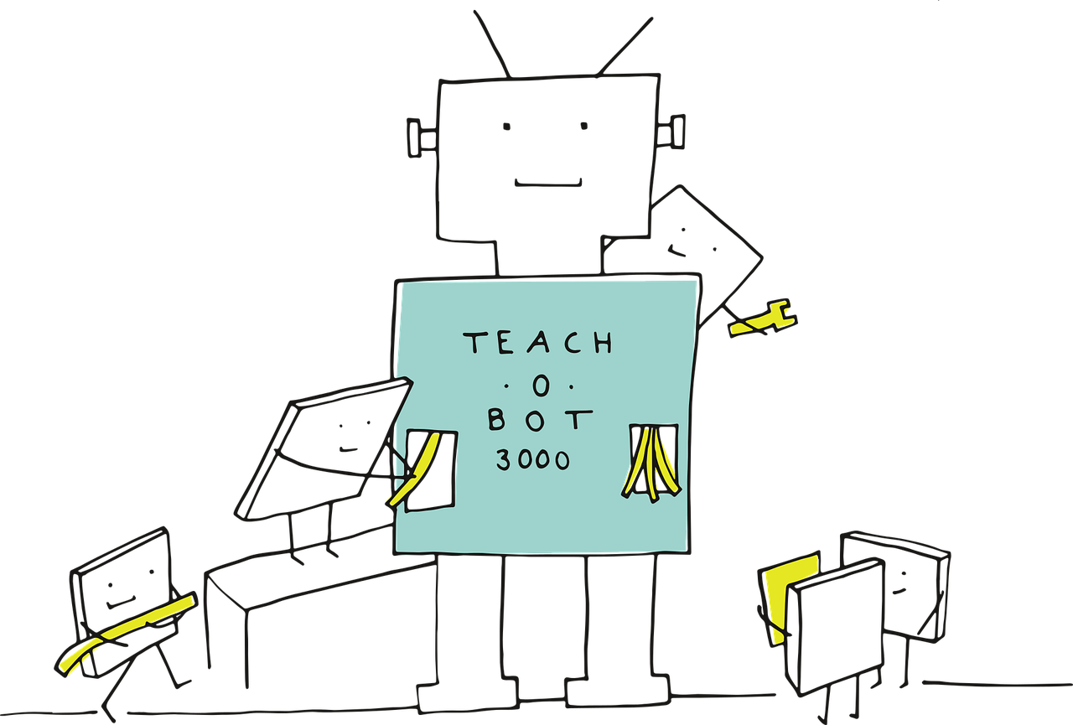
What is a Machine Learning Algorithm?
An algorithm that can learn from data

Slide 3
Machine Learning Seeks to Answer...
How can we build computer systems that automatically improve with experience?
What are the laws that govern all learning processes?

Slide 4
Examples of Machine Learning
Data mine historical medical records to learn which treatment you will best respond to
Build search engines that automatically customize to your interest

Slide 5

Examples of Machine Learning
Design autonomous robots that learn to navigate from their own experience

Slide 6
When should you use machine learning?
When the software is too complex to manually design
When the software should change after it is released

Slide 7
3 Branches of Machine Learning
Supervised Learning
Unsupervised Learning
Reinforcement Learning

Slide 8
Workflow
Gather Data
Preprocess Data
Train Data
Train Model
Test Model
Deploy Model
model/parameter tuning loop

Slide 9
What is Machine Learning? ✓

